Slide 1
TITLE - KEYLOGGER AND SECURITY
CAPSTONE PROJECT
Presented By:
1.Niranchan P - JEPPIAAR INSTITUTE OF TECHNOLOGY-
B.TECH-INFORMATION TECHNOLOGY

Slide 2
OUTLINE
Problem Statement (Should not include solution)
Proposed System/Solution
System Development Approach (Technology Used)
Algorithm & Deployment
Result (Output Image)
Conclusion
Future Scope
References

Slide 3
Problem Statement
To design and build a strong keylogger system that keeps sensitive user data safe from unauthorized access and potential security breaches.
This keylogger should be able to record keystrokes from different input sources, including physical and virtual keyboards. It's crucial that the system ensures the confidentiality, integrity, and availability of the logged data at all times.
Alongside capturing keystrokes, the system must use effective security measures to stop any unauthorized attempts to intercept or tamper with the recorded data.
To make the system strong against threats, we'll include essential features like encryption, user authentication, access control, and regular security checks.
Our main goal is to create a reliable keylogging solution that boosts security while also protecting user privacy and making sure the system remains easy to use.

Slide 4
Proposed Solution
1. System Architectural Design:
Create a structured architecture with different modules: keylogging, encryption, authentication, access control, and auditing.
2. Keylogging Function Implementation:
Build a strong keylogging component to capture keystrokes from various input sources reliably and efficiently.
3. Encryption and Data Security:
Use AES encryption to protect logged keystrokes, ensuring data confidentiality and integrity.
4. Authentication, Authorization and Access Control:
Implement secure user authentication with password hashing and role-based access control (RBAC) to limit access to authorized users.
5. Security Monitoring, Control and Auditing:
Include logging and auditing features to monitor system activities, identify security issues, and support forensic analysis.

Slide 5
System Approach
The system will be developed using Python, utilizing the pynput library for keystroke capture and Tkinter for GUI development. It will consist of two main components:
Keylogger Module:
This module will utilize pynput.keyboard to capture keystrokes.
Functions will be defined to manage key press and release events, storing captured keystrokes in memory.
Periodically, the keystrokes will be written to output files (key_log.txt and key_log.json).
Graphical User Interface (GUI):
Built with Tkinter, the GUI will offer buttons to start and stop the keylogging process.
It will display status messages to indicate whether the keylogger is active.
Technology Used:
Python: For programming the keylogger functionality.
Tkinter: For building the graphical user interface (GUI).
pynput: For capturing keyboard inputs.
JSON: For storing keystroke data in a structured format.

Slide 6
Algorithm & Deployment
STEP 1: Initialization
Initialize necessary variables and flags.
STEP 2: Event Handling
on_press(key): Records pressed and held keys.
on_release(key): Records released keys and manages flag state.
STEP 3: Logging
generate_text_log(key): Saves keystrokes in a text file.
generate_json_file(keys_used): Saves keystrokes in a JSON file.
STEP 4:Keylogger Control
start_keylogger(): Initiates keylogging process.
stop_keylogger(): Stops keylogging.

Slide 7
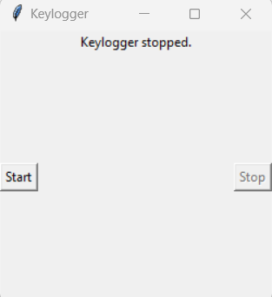
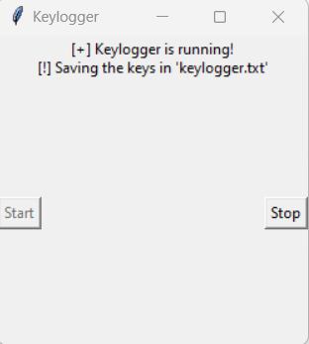
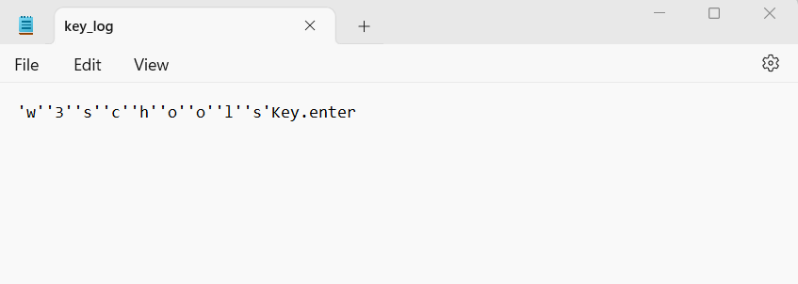
RESULT
The GUI presents "Start" and "Stop" buttons to control the keylogging process
Upon execution, the keylogger application will run in the background, capturing all keystrokes made by the user. The captured data will be stored in both text and JSON formats for later analysis.
The GUI will provide user-friendly controls to initiate and terminate the keylogging process, along with status updates.

Slide 8
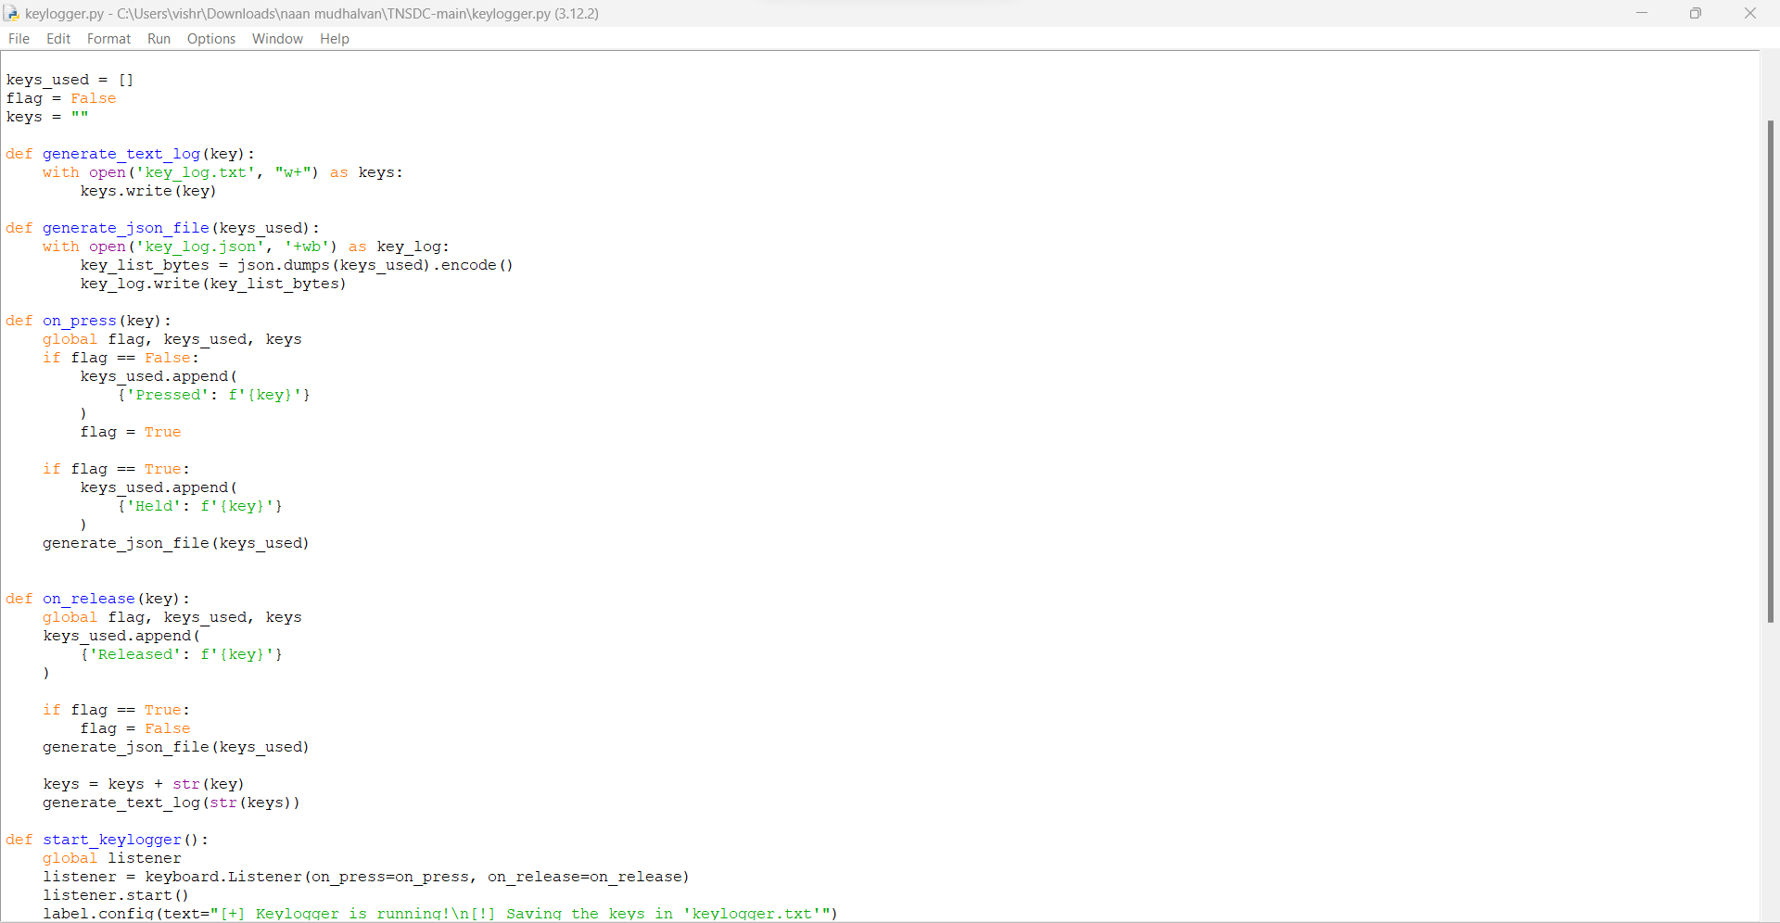
OUTPUT

Slide 9
Conclusion
The developed keylogger application provides a simple yet effective tool for monitoring keystrokes on a system. While primarily intended for security purposes, it can also serve as a learning tool for understanding keyboard events in Python programming. However, it's crucial to use such tools responsibly and ethically, respecting user privacy and legal boundaries.

Slide 10
Future scope
Encryption of captured keystrokes for enhanced security.
Addition of features to filter and analyze keystrokes based on specific criteria.
Integration with cloud storage services for remote data backup.
Implementation of machine learning algorithms for anomaly detection in keystroke patterns.

Slide 11
References
A Survey on Keylogger and its Detection Techniques by Vishal Bharti, Aditya Kumar Gupta, and Shailendra Mishra https://www.ijcaonline.org/archives/volume75/number5/12835-1514
Analysis of Keylogger Attacks and Countermeasures by Hongliang Liu, Ruiying Du, and Quansheng Zhuang https://www.semanticscholar.org/paper/Analysis-of-Keylogger-Attacks-and-Countermeasures-Liu-Du/54c7255bace229c82e4a5fd812ba8dd8829180c1
Detection of Keyloggers: A Review by Shukor Abd Razak, Ku Ruhana Ku-Mahamud, and Ramlan Mahmod https://www.researchgate.net/publication/220955239_Detection_of_Keyloggers_A_Review

Slide 12
THANK YOU

